Slide 1


Λ*(1520) Photoproduction off Proton and Neutron from CLAS eg3 data set
Zhiwen Zhao
NSTAR 2011
2011/05/19
Physics motivation
Data analysis
Results
Summary

Slide 2
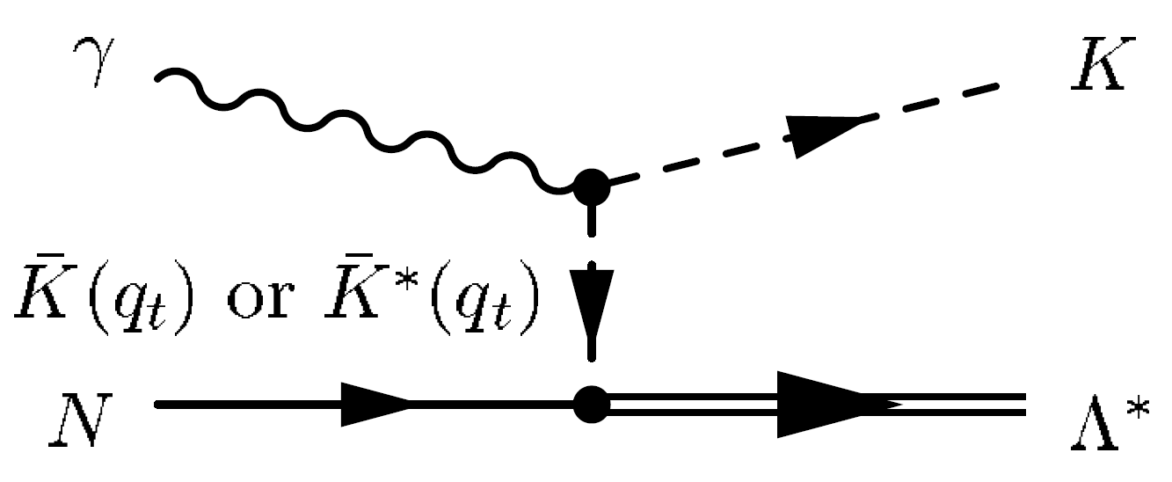
Physics Motivation
Λ(1520) I( J ^{P} ) = 0( 3/2 ⁻ )
Mass m = 1519.5 ± 1.0 MeV Full width Γ = 15.6 ± 1.0 MeV
Its production mechanism is poorly understood due to lack of data.
Existing data suggest dominance of t-channel processes and K, K* exchange.
Several model predictions for total and differential cross sections are available.
Measurement of cross section and decay angular distribution can provide constraints on model prediction and insights into the production mechanism.
Possible missing N* resonances may decay through strange channels.

Slide 3
Published Experiment
1. on Proton
photoproduction measurements
[1] A. Boyarski et al., (LAMP2, Daresbury), (1971)
[2] D. Barber et al., (SLAC), (1980)
[3] N. Muramatsu et al., (LEPS), (2009)
[4] H. Kohri et al., (LEPS), (2010)
[5] F. W. Wieland et al., (SAPHIR), (2010)
electroproduction measurements
[5] T. Azemoon et al., (DESY), (1975)
[6] S. P. Barrow et al. (CLAS, JLab), (2001)
[7] Y. Qiang et al. (Hall-A, JLab), (2010)
2. on Neutron
photoproduction measurements
[3] N. Muramatsu et al., (LEPS), (2009)
Published Theory
S. Nam et al. Phys. Rev. D, 71, 114012 (2005)
S. Nam et al. Phys. Rev. D, 75, 014027 (2007)
S. Nam et al. Phys. Rev. C, 81, 055206 (2010)
A. Titov et al. Phys. Rev. C, 72, 035206 (2005)

Slide 4
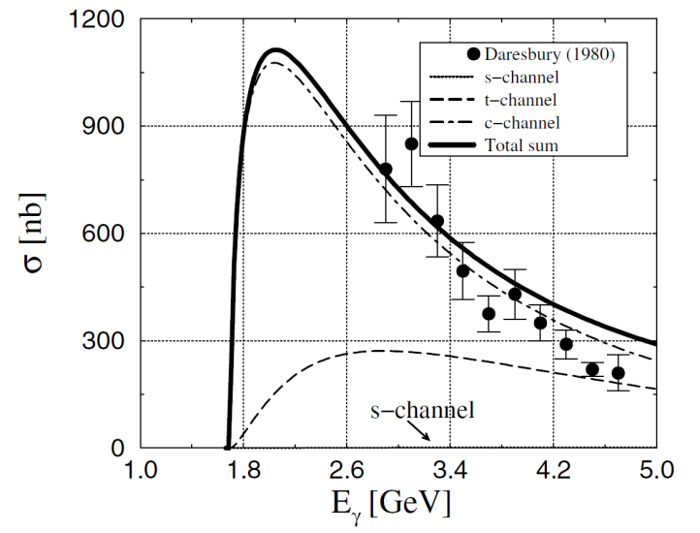
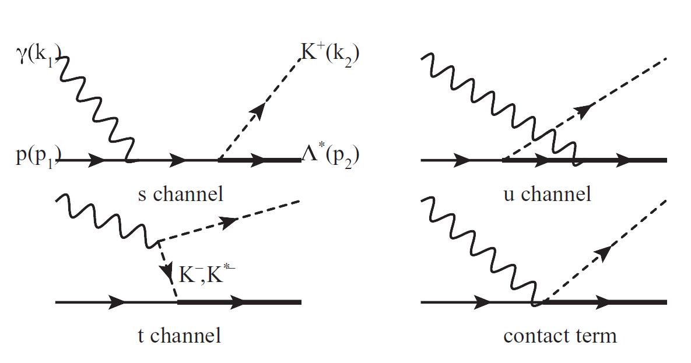
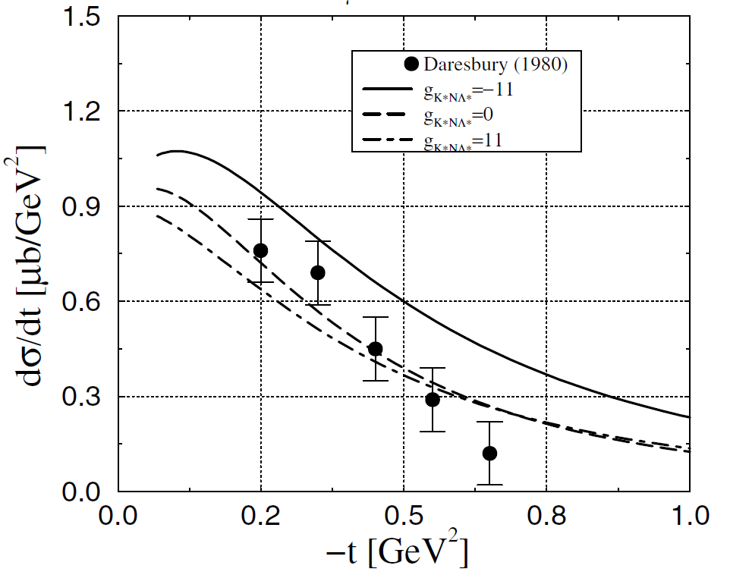
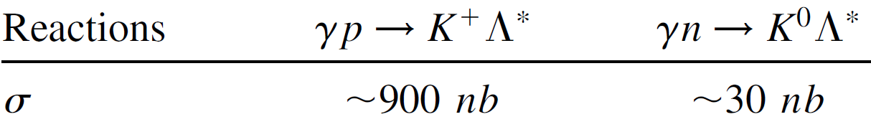
Cross Section photoproduction
Comparing Proton results between data and theory
>>
?
Cross sections of Neutron much
smaller than Proton
S. Nam et al. Phys. Rev. D, 71, 114012 (2005)

Slide 5
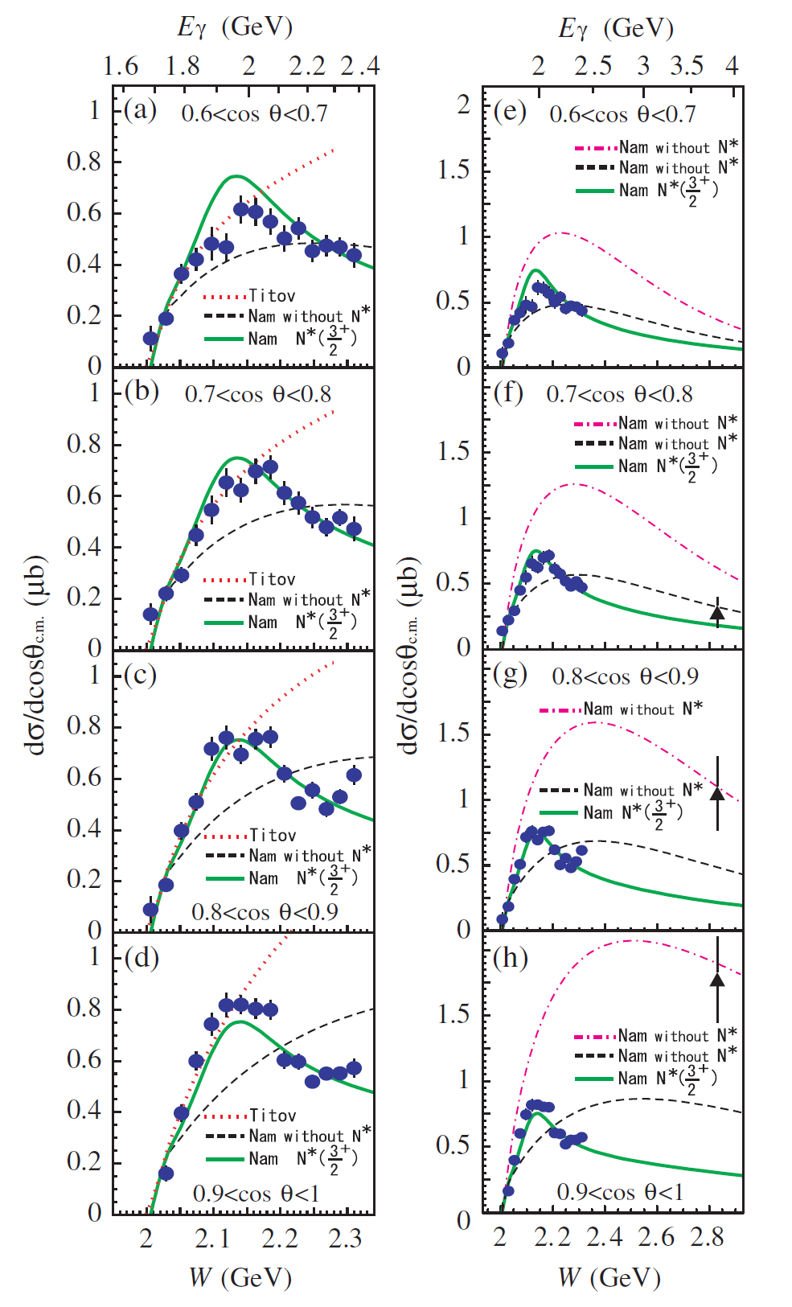
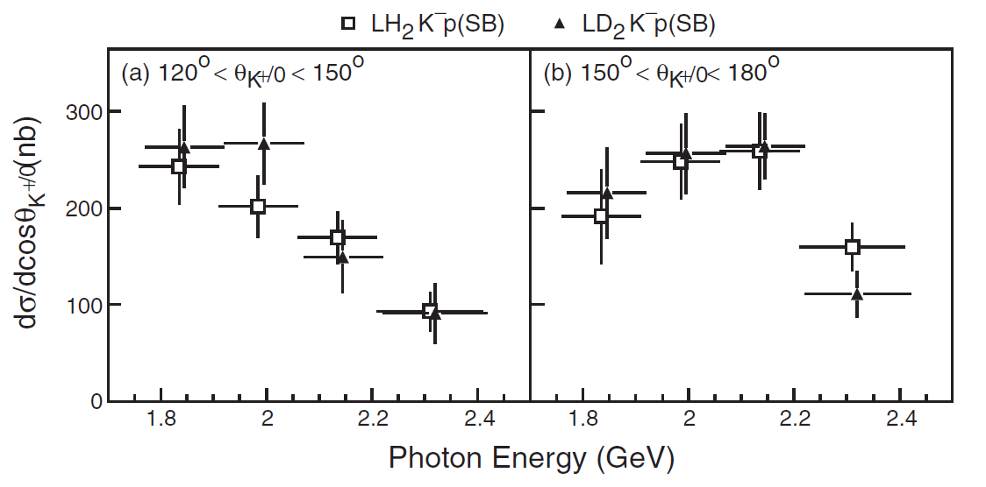
Cross Section photoproduction
LEPS Results
Show both forward and backward angle differential cross sections on Proton.
Enhancement close to threshold is interpreted as a resonance structure.
Very small cross sections on Neutron from indirect measurement.

Slide 6
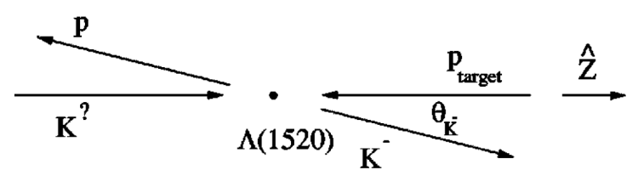

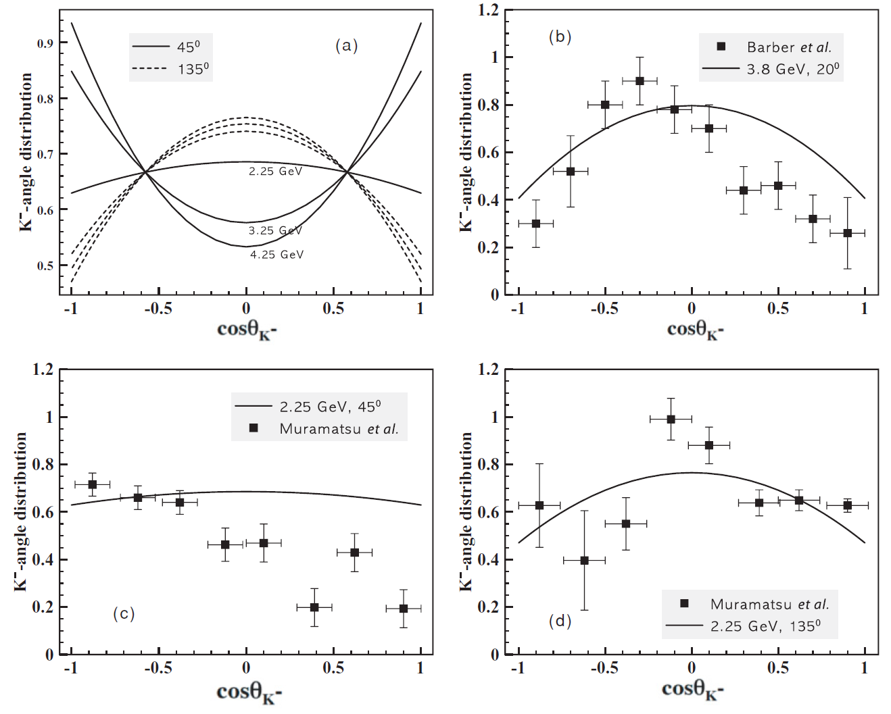
Decay Angle photoproduction
Decay angle distribution
Gottfried-Jackson frame
m_{z}=1/2
m_{z}=3/2
interference
Λ* J^{P} = 3/2 ⁻ | m_{z}=1/2 | m_{z}=3/2 | β/α
N(1/2 ⁺)K (0 ⁻) | Y | N | 0
N(1/2 ⁺) K*(1 ⁻) | Y | Y | 3/1
Decay angle distribution is related to production mechanism.

Slide 7
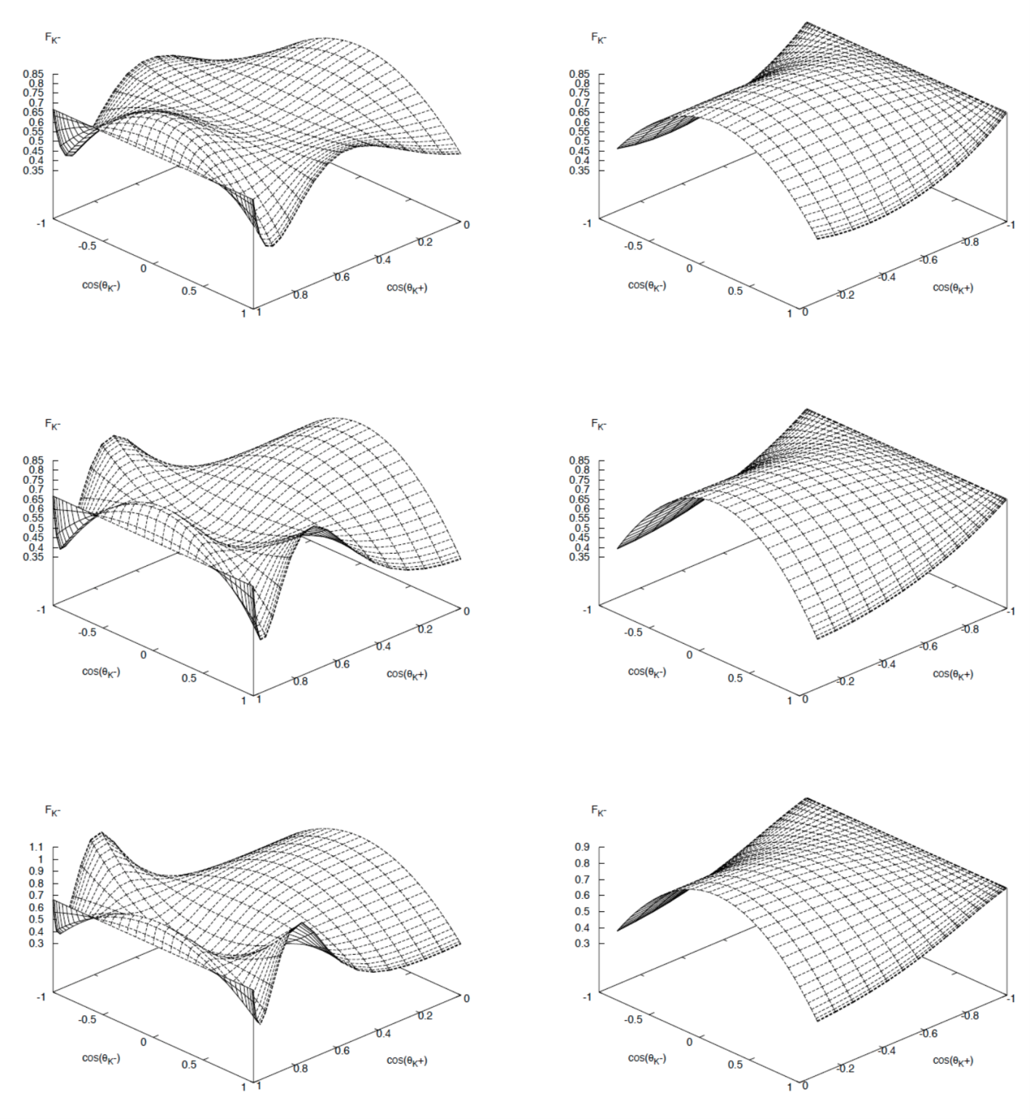
Decay Angle photoproduction
θ_{K}^{CM} forward backward
cosθ_{K}^{-GJ}
cosθ_{K}^{CM}

Slide 8
Reaction Channels
exclusive
deuteron target
γp(n) → K⁺ Λ* (n) Proton
γn(p) → K⁰ Λ* (p) Neutron
(Λ* →p K⁻ , K⁰ → K_{s} → π ⁺ π ⁻ )
eg3 run
Photon beam electron beam 5.77 GeV, tagged photon energy 1.15 < E < 5.5 GeV, 30 nA
Target 40 cm upstream, LD²
Trigger Tagger 4.5 < E < 5.5 GeV, STxTOF (3 sectors and prescaled 2 sectors)
Torus field optimized to -1980 A, negative charged particles outbending
Run period 12/06/2004 – 01/31/2005, 29 days of production on LD² target
Data 4.2 billion physics events, 32 TB raw data, average 2.7 tracks/event

Slide 9
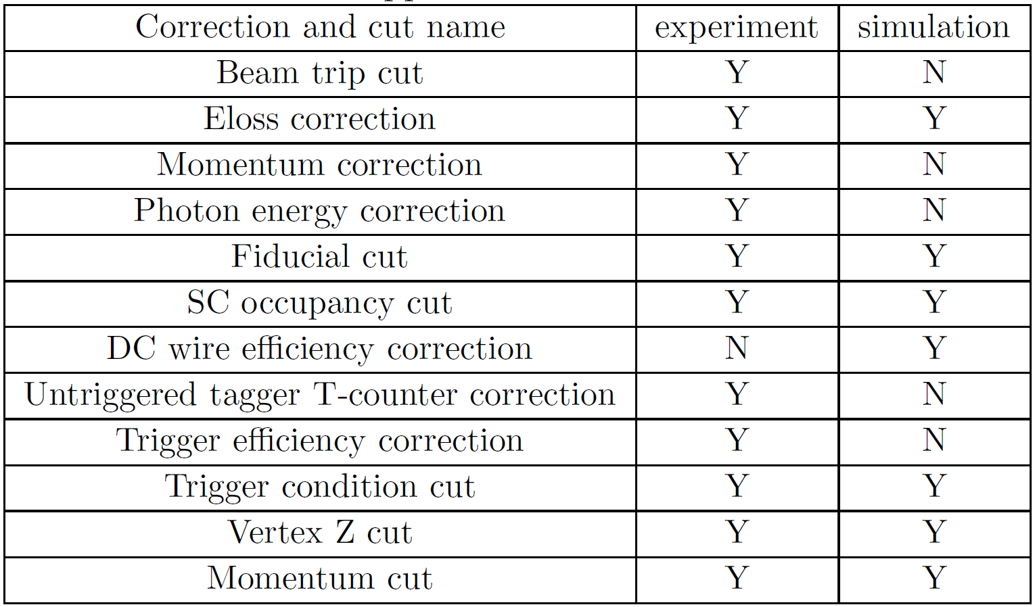
Correction and Cuts Applied

Slide 10
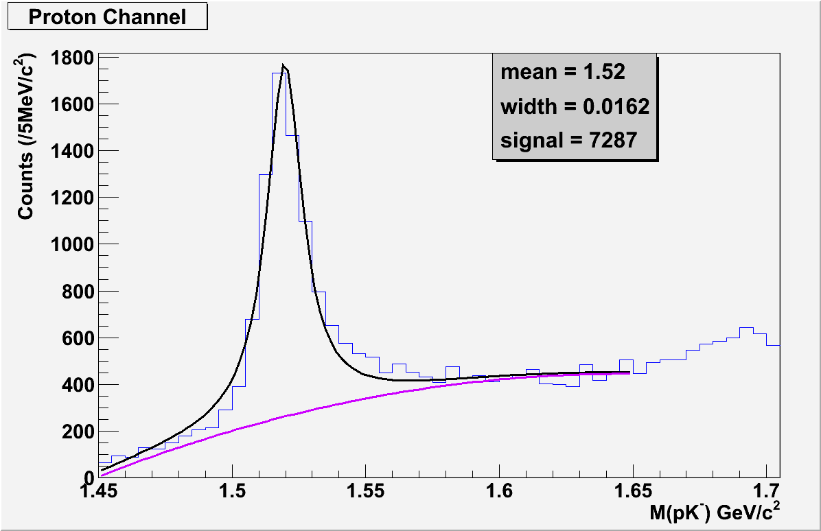
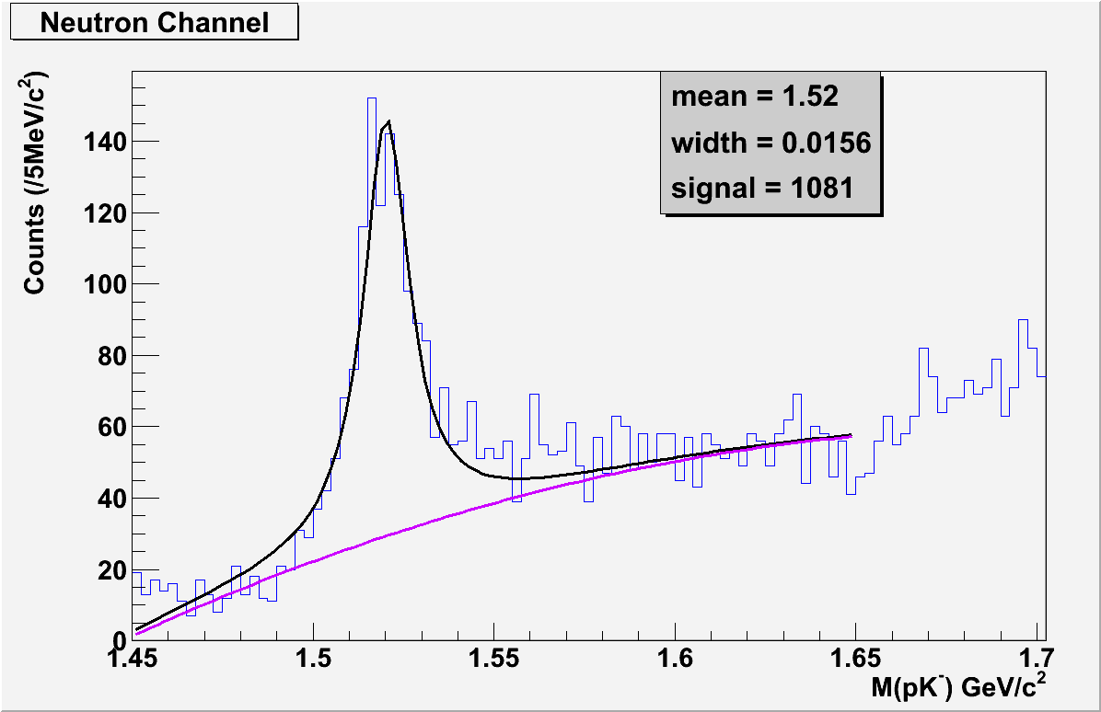
Invariant Mass of pK⁻
Proton
Neutron

Slide 11
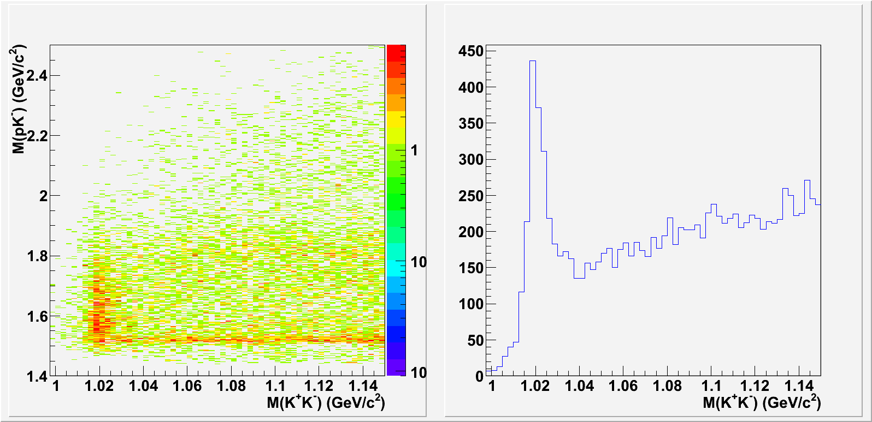
Invariant Mass of K⁺K⁻
Proton

Slide 12
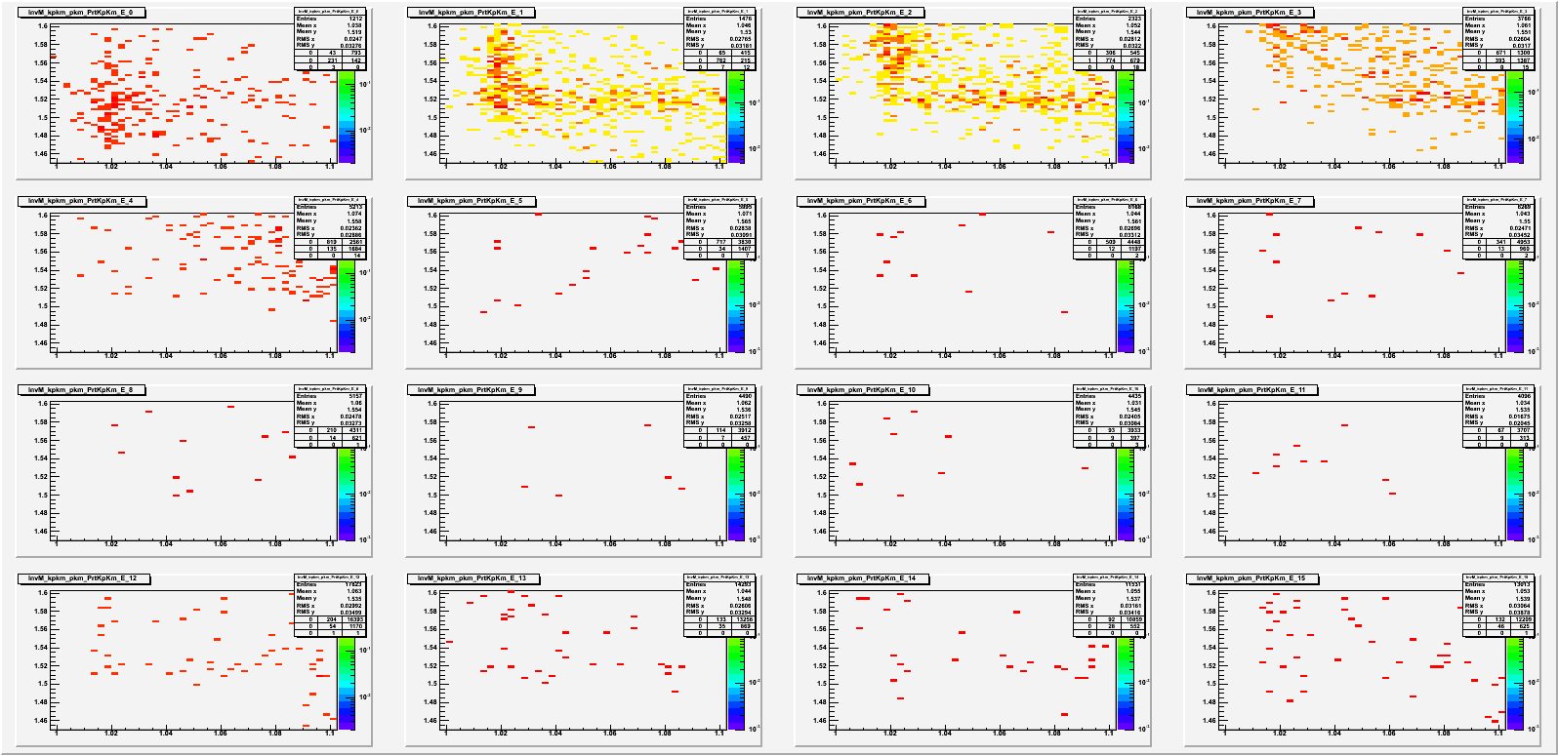
Invariant Mass of K⁺K⁻
Proton
E_{γ} < 2.25 GeV

Slide 13
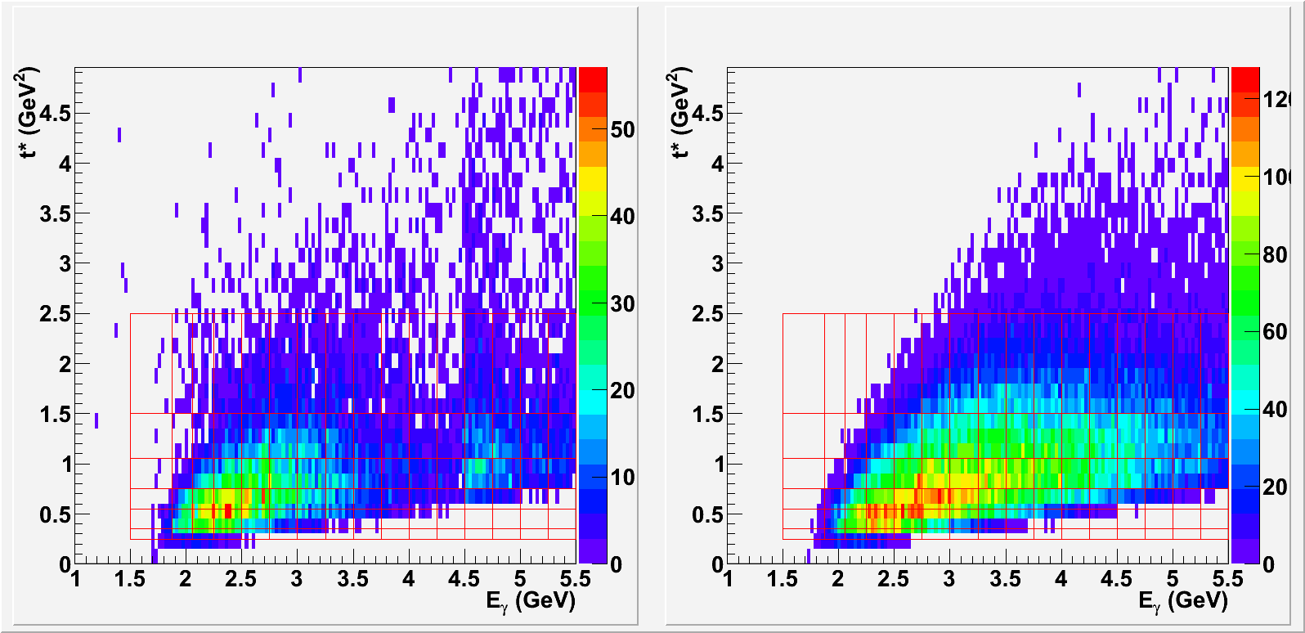
Kinematic Distribution
Proton
1.5 < E_{γ} < 5.5 GeV
16 bins, bin width 250 MeV
0.25 < t* = -(t-t₀) < 2.5 GeV²
6 bins, bin width varies
Data Simulation
t*=-(t-t₀) (GeV²)
t*=-(t-t₀) (GeV²)
E_{γ} (GeV)
E_{γ} (GeV)

Slide 14
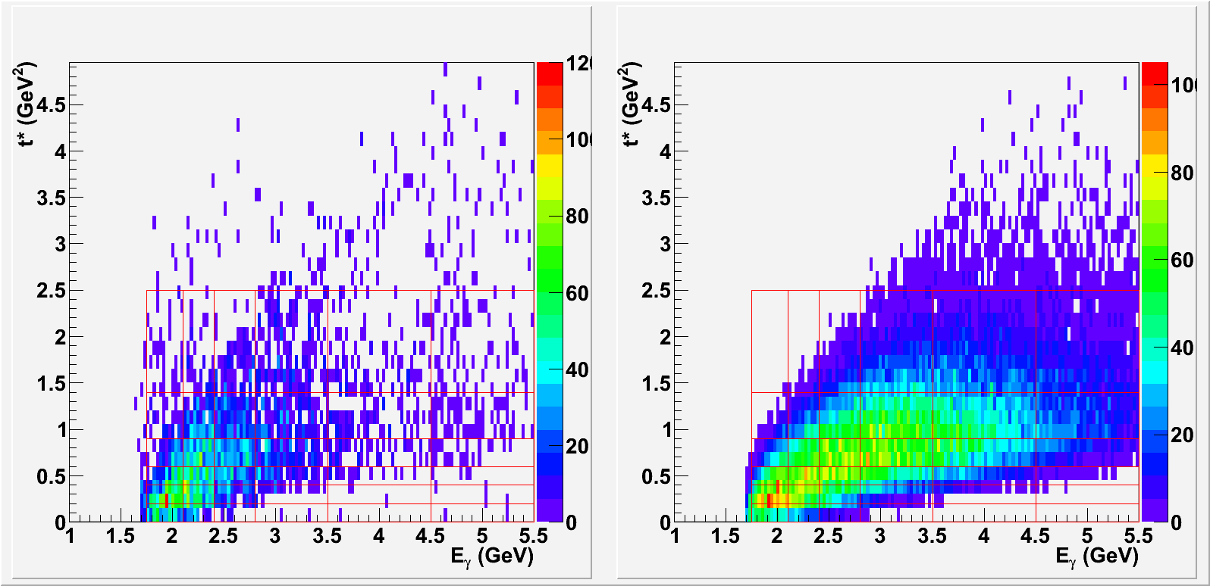
Kinematic Distribution
Neutron
1.5 < E_{γ} < 5.5 GeV
6 bins, bin width varies
0.0 < t* = -(t-t₀) < 2.5 GeV²
6 bins, bin width varies
Data Simulation
t*=-(t-t₀) (GeV²/c⁴)
t*=-(t-t₀) (GeV²/c⁴)
E_{γ} (GeV)
E_{γ} (GeV)

Slide 15
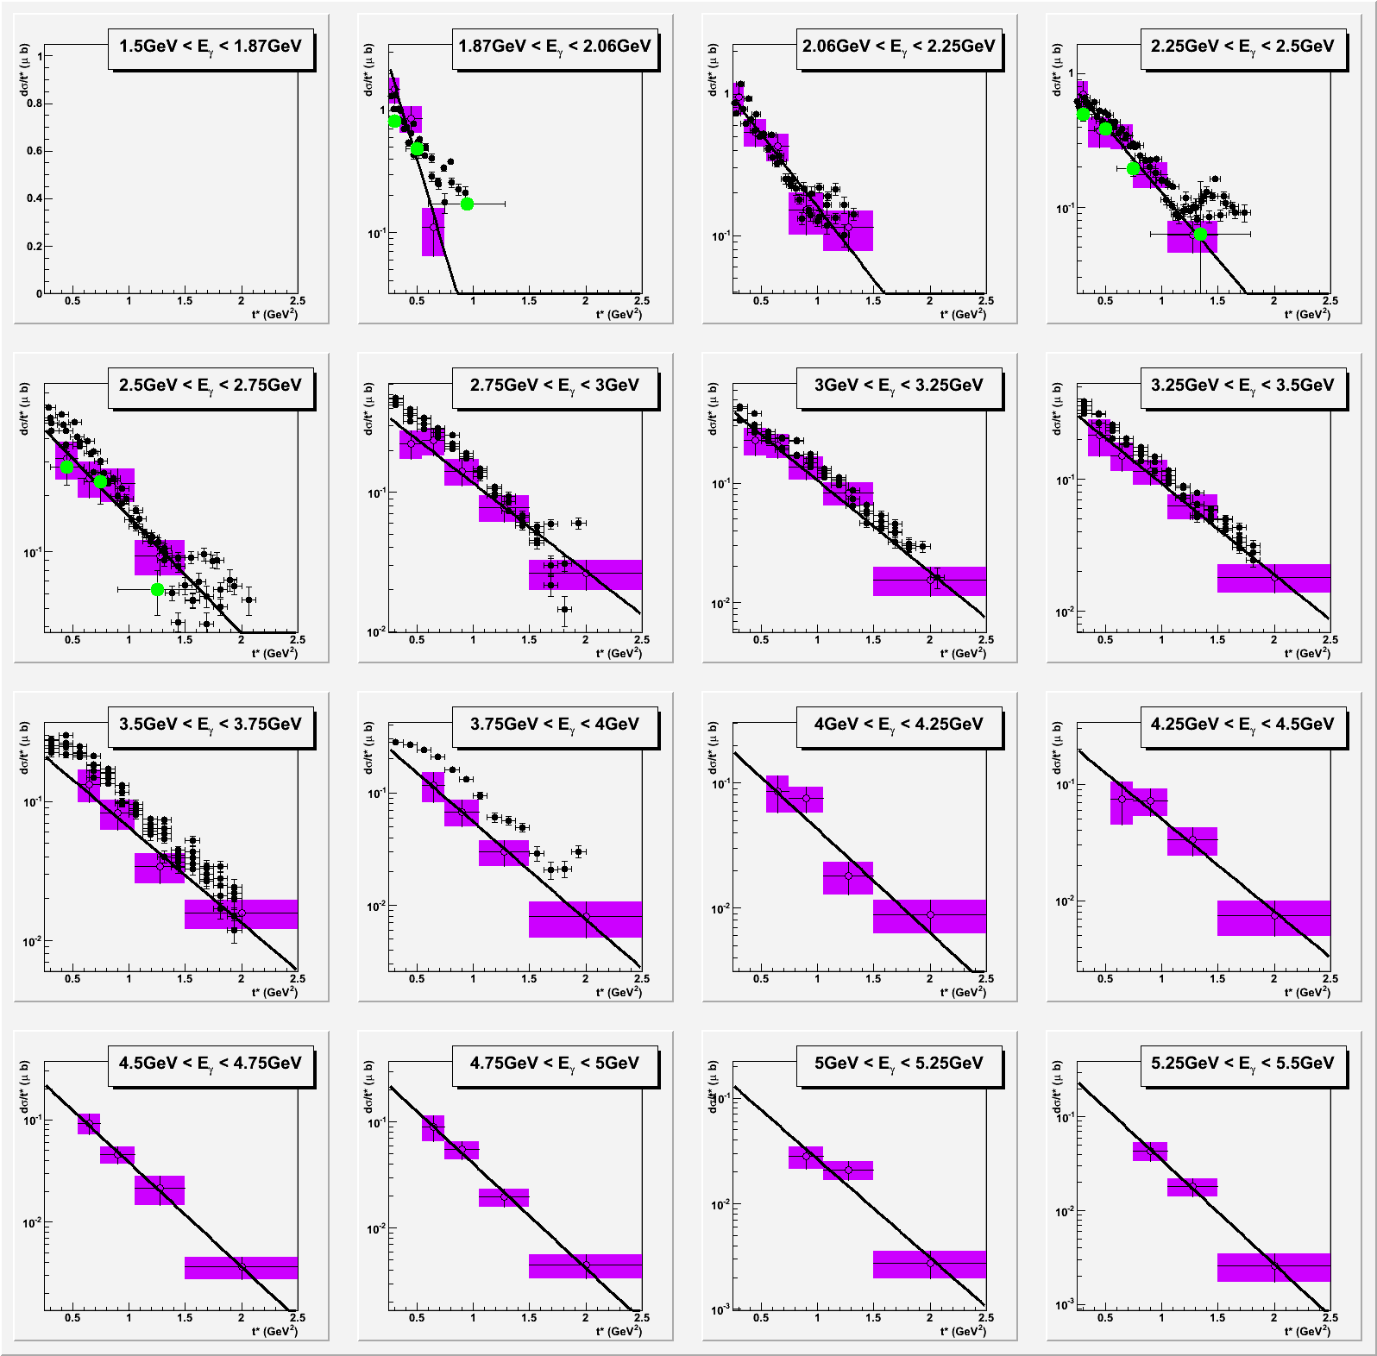
Differential Cross Section
Preliminary
Proton
dσ/dt*
dσ/dt* (µb)
1.5 < E_{g} < 5.5 GeV
16 bins, bin width 250 MeV
Fit with function of αe ^{– βt*}
Extrapolate the function and integrate over t* to obtain total cross sections
t* (GeV²)

Slide 16
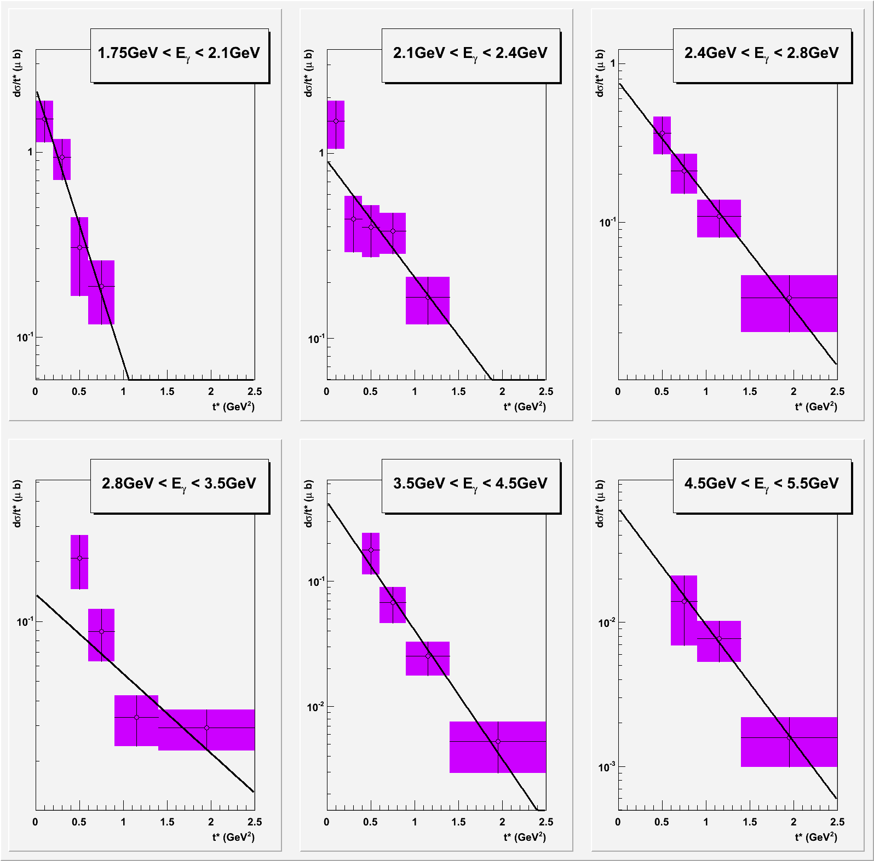
Differential Cross Section
Preliminary
Neutron
dσ/dt*
dσ/dt * (µb)
1.5 < E_{g} < 5.5 GeV
6 bins, bin width varies.
Fit with function of αe ^{– βt*}
Extrapolate the function and integrate over t* to obtain total cross sections
t* (GeV²)

Slide 17
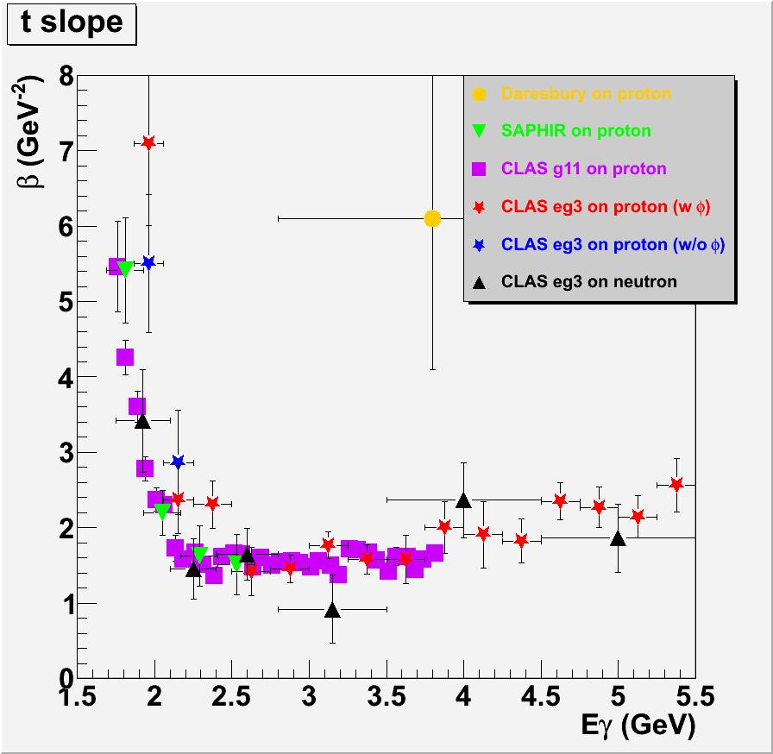
t-slope
Preliminary

Slide 18
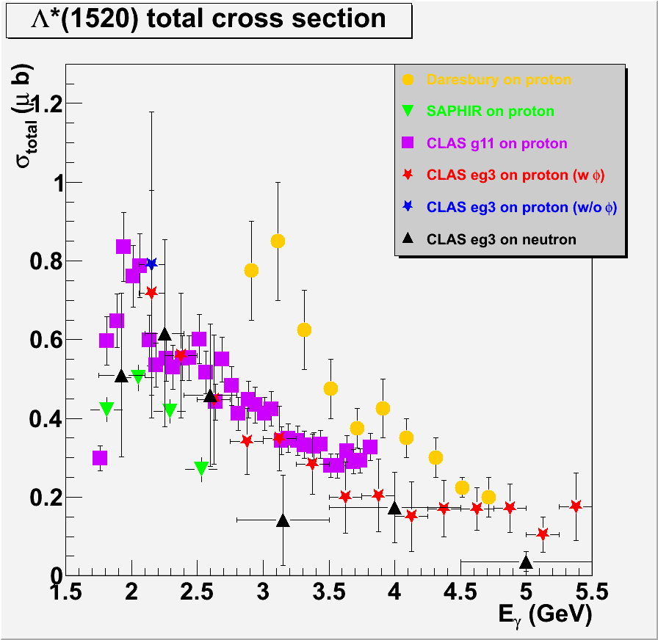
Total Cross Section
Preliminary

Slide 19
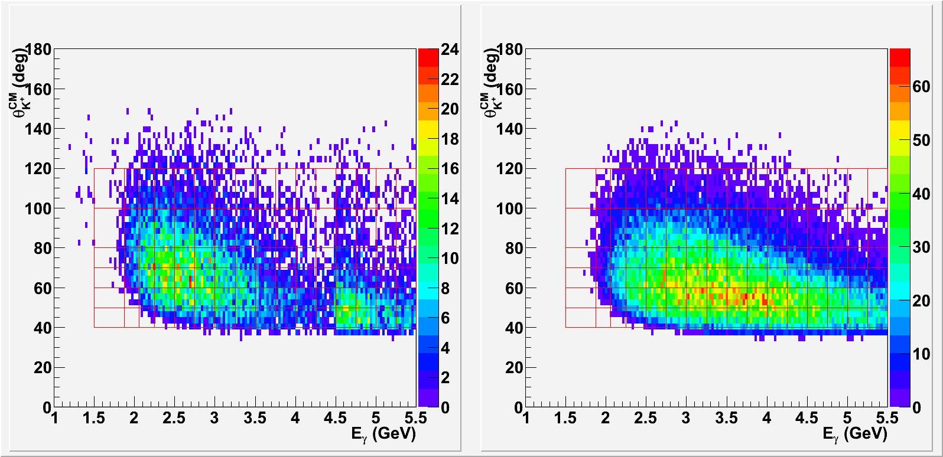
Kinematic Distribution
Proton
1.5 < E_{γ} < 5.5 GeV
16 bins, bin width 250 MeV
40 < θ_{K}^{CM} < 120º
6 bins, bin width varies
Data Simulation
θ_{K}^{CM}
θ_{K}^{CM}
E_{γ} (GeV)
E_{γ} (GeV)

Slide 20
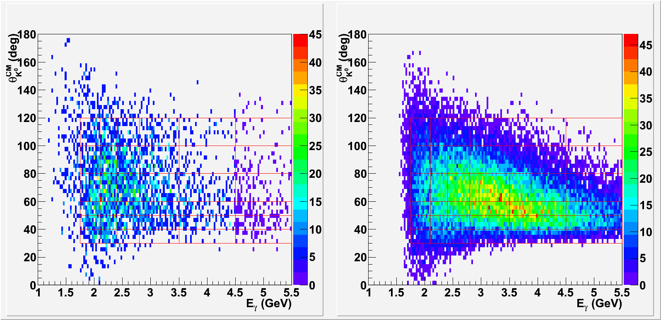
Kinematic Distribution
Neutron
1.5 < E_{γ} < 5.5 GeV
6 bins, bin width varies
30 < θ_{K}^{CM} < 120º
6 bins, bin width varies
Data Simulation
θ_{K}^{CM}
θ_{K}^{CM}
E_{γ} (GeV)
E_{γ} (GeV)

Slide 21
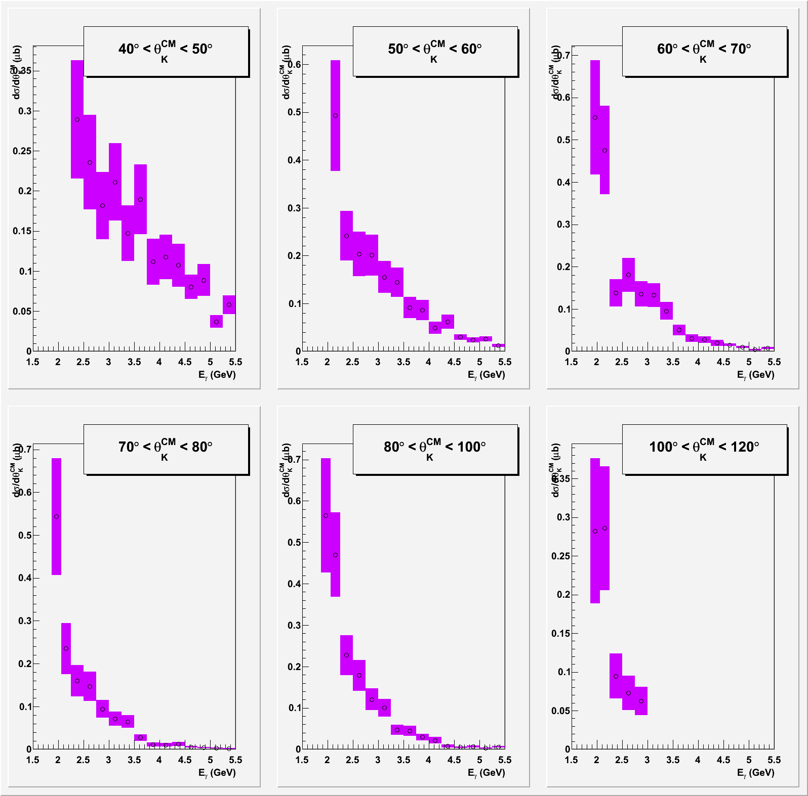
Differential Cross Section
Preliminary
Proton
dσ/dθ_{K}^{CM}
dσ/dθ_{K}^{CM} (µb)
40º < θ_{K}^{CM} < 120º
6 bins, bin width varies
No sign of resonance structure within the statistics
E_{γ} (GeV)

Slide 22
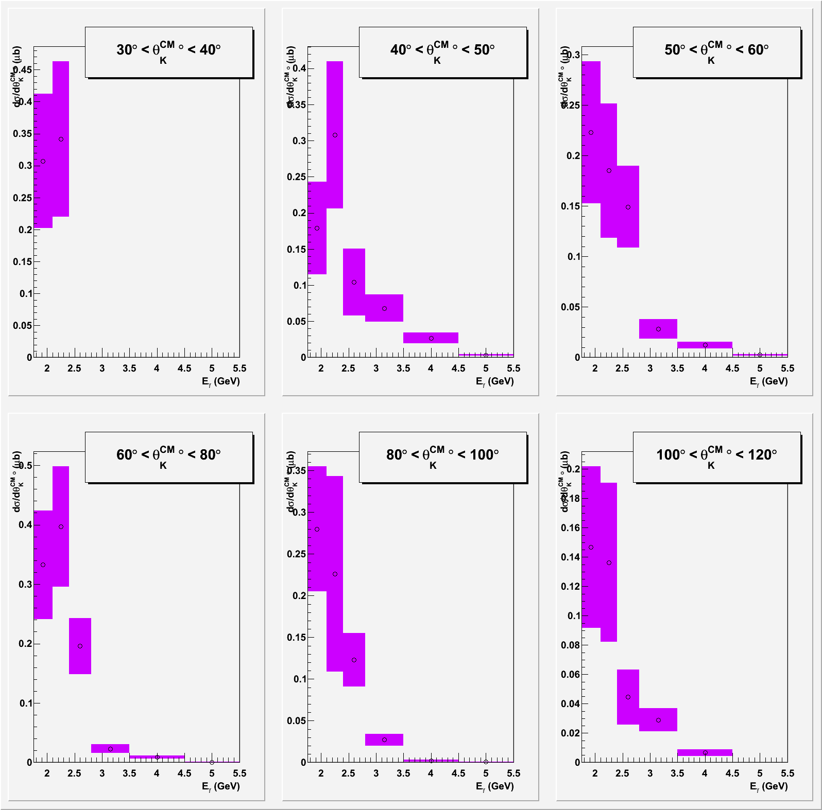
Differential Cross Section
Preliminary
Neutron
dσ/dθ_{K}^{CM}
dσ/dθ_{K}^{CM} (µb)
20º < θ_{K}^{CM} < 120º
6 bins, bin width varies
No sign of resonance structure within the statistics
E_{γ} (GeV)

Slide 23
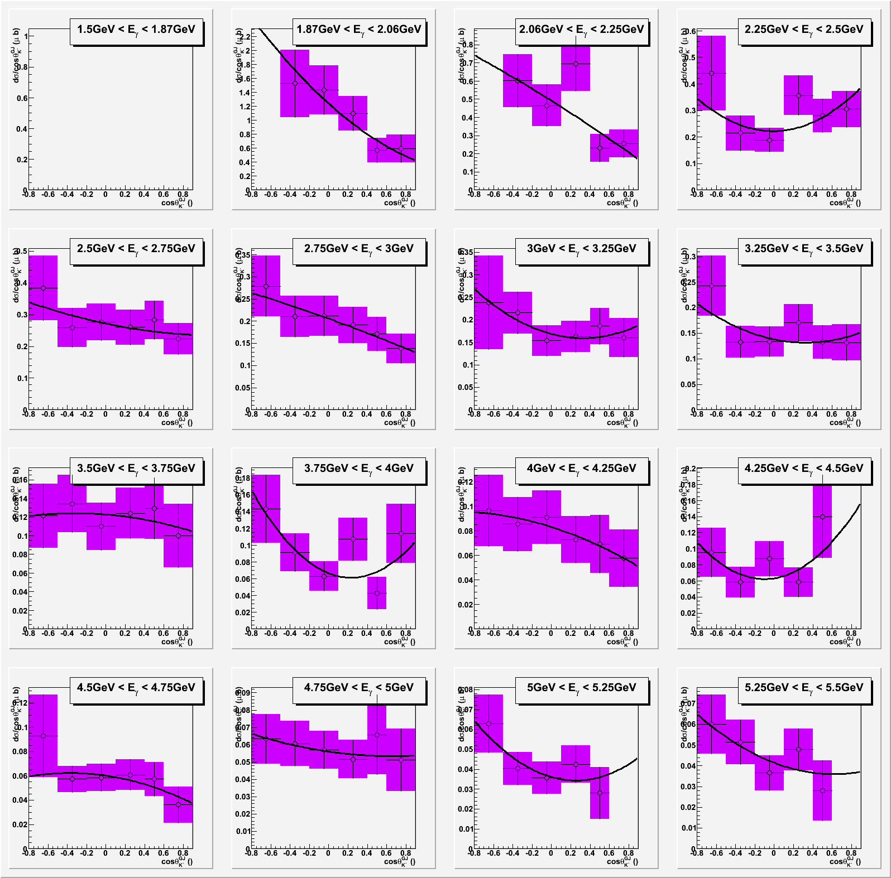
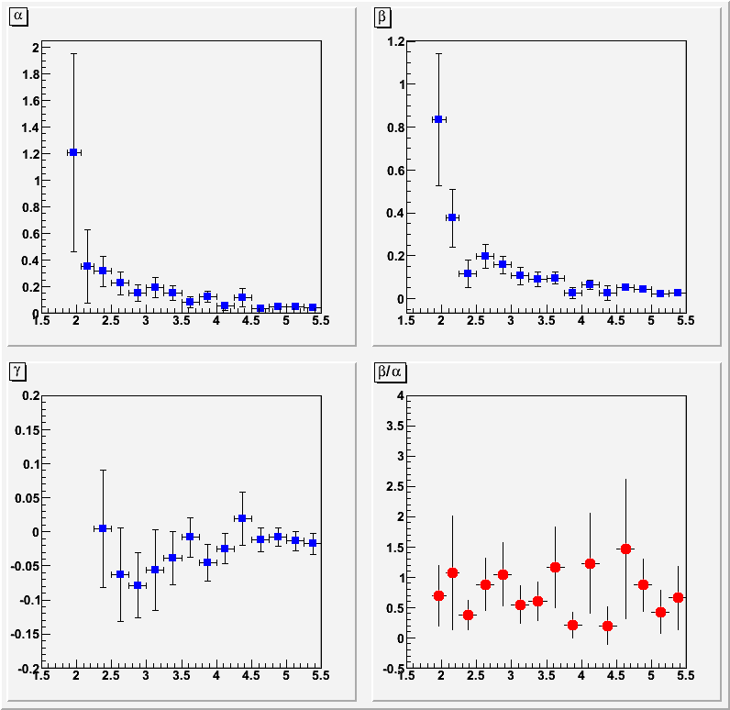
Decay Angle Distribution
Preliminary
Proton
dσ/dcosθ_{K}^{-GJ}
dσ/dθ_{K}^{-CJ} (µb)
1.5 < E_{g} < 5.5 GeV
16 bins, bin width 250 MeV
Mixture of K and K* exchange
cosθ_{K}^{-GJ}

Slide 24
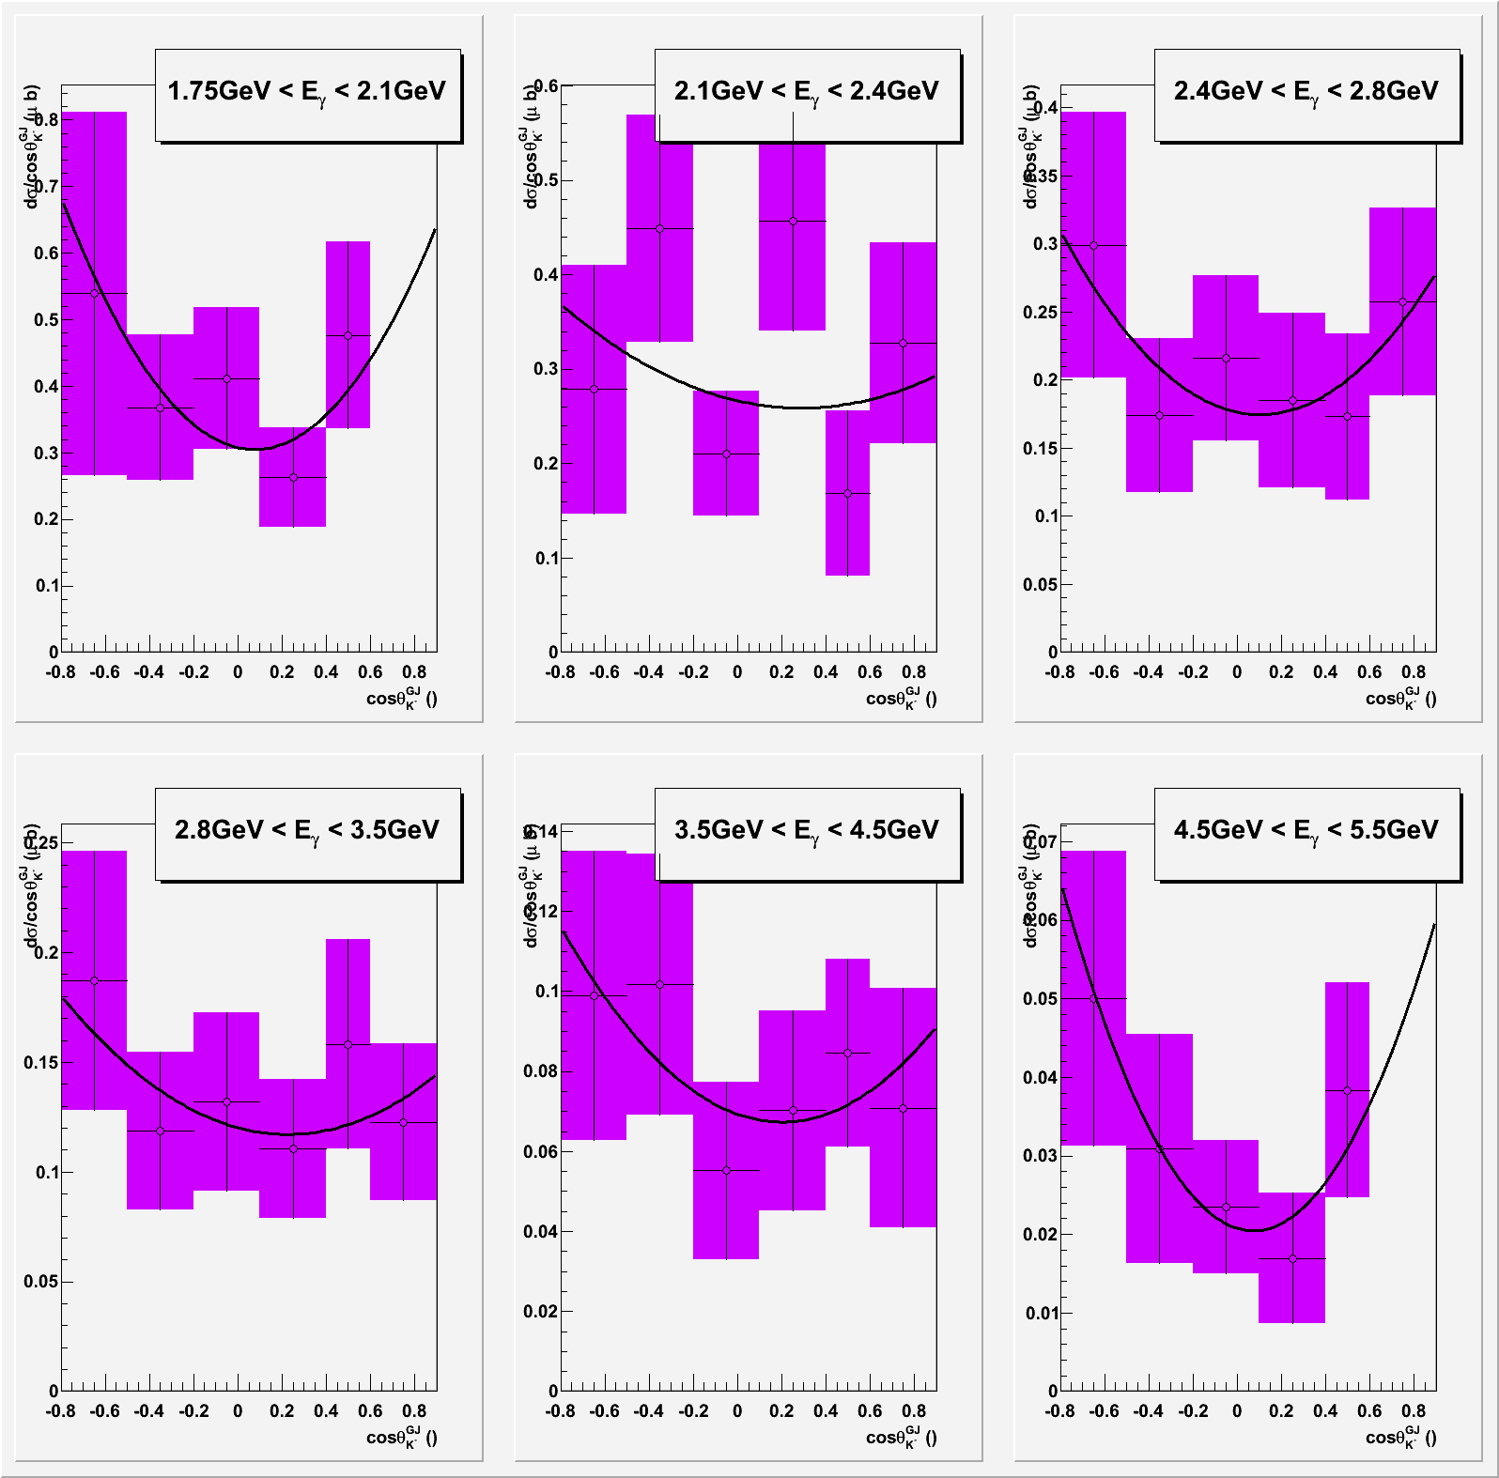
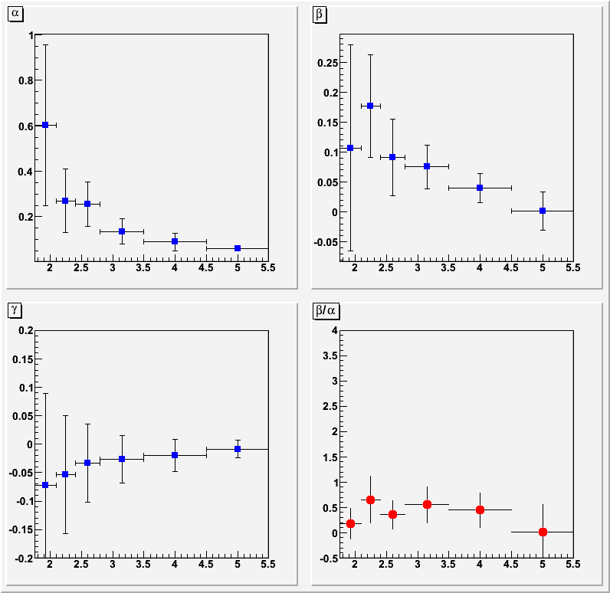
Decay Angle Distribution
Preliminary
Neutron
dσ/dcosθ_{K}^{-GJ}
dσ/dθ_{K}^{-CJ} (µb)
1.5 < E_{g} < 5.5 GeV
6 bins, bin width varies
Mixture of K and K* exchange
cosθ_{K}^{-GJ}

Slide 25
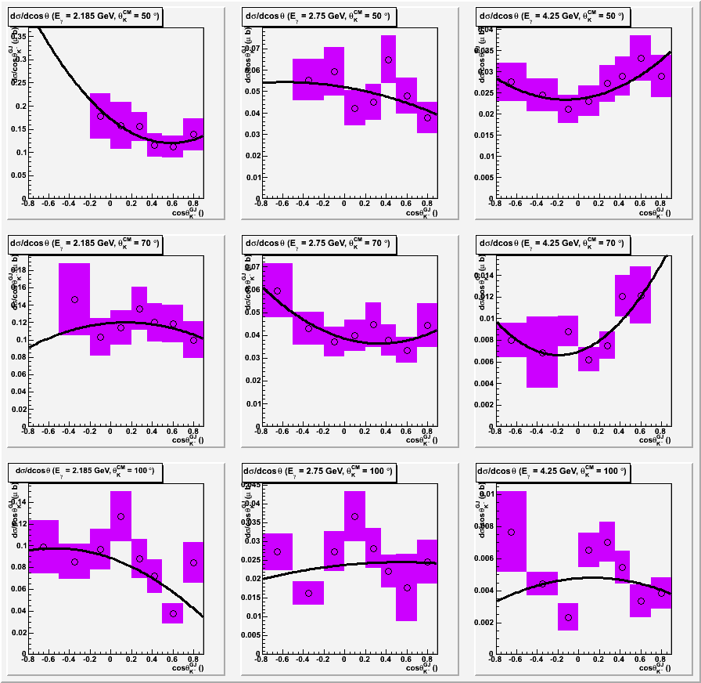
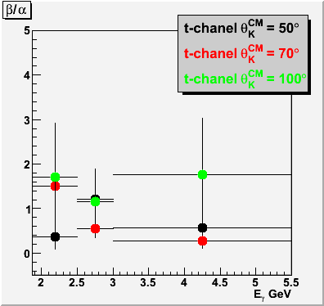
Decay Angle Distribution
Preliminary
Proton
E _{γ} = 2.185 2.75 4.35 GeV
dσ/dcosθ_{K}^{-GJ}
Mixture of K and K*
exchange
dσ/dθ_{K}^{-CJ} (µb)
θ_{K}^{CM} = 50 70 100 DEG
cosθ_{K}^{-GJ}

Slide 26
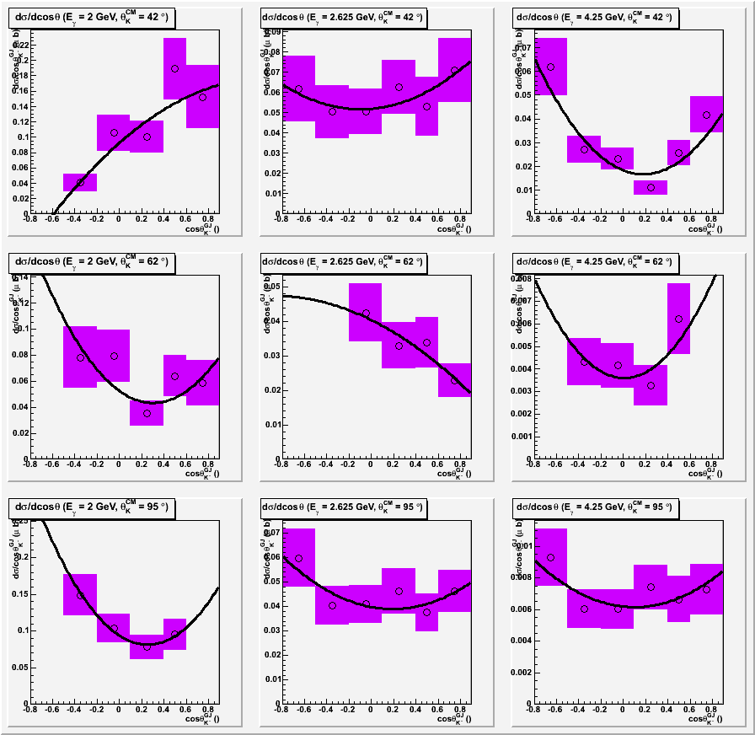
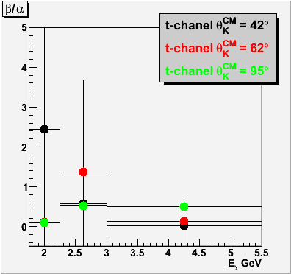
Decay Angle Distribution
Preliminary
Neutron
E _{γ} = 2.0 2.625 4.35 GeV
dσ/dcosθ_{K}^{-GJ}
Mixture of K and K*
exchange
dσ/dθ_{K}^{-CJ} (µb)
θ_{K}^{CM} = 42 62 95 DEG
cosθ_{K}^{-GJ}

Slide 27
Summary
The Λ*(1520) differential and total cross sections up to 5.5 GeV on Proton are extracted. The total cross section is in good agreement with the world data.
The Λ*(1520) differential and total cross sections on Neutron are obtained for the first time. The cross section is about 70% of the proton channel result, which is much larger than what the theory predicted.
There is no sign of resonance structures at the covered forward kaon angles.
Λ*(1520) decay angle distributions in Gottfried-Jackson frame show complicated structures indicating that both K and K* exchanges contribute to the two reaction channels.

Slide 28
Backup

Slide 29
Existing Data electroproduction
Electroproduction of Λ* off Proton has been studied at DESY and CLAS
CLAS data (S. Barrow, e1c) showed
  Dominance of t-channel process confirmed
  Decay angular distribution showed significant contribution from m_{z}=±1/2 spin projection

Slide 30
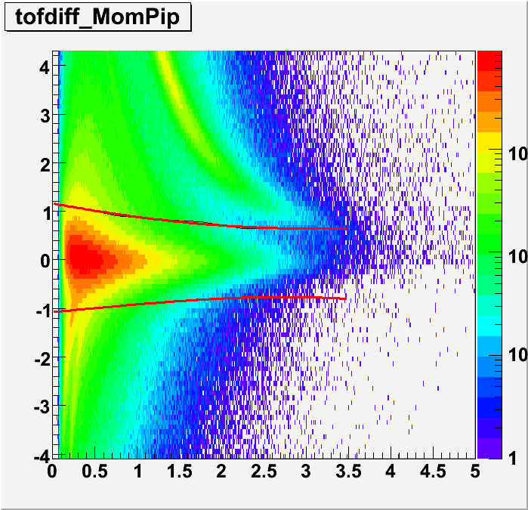
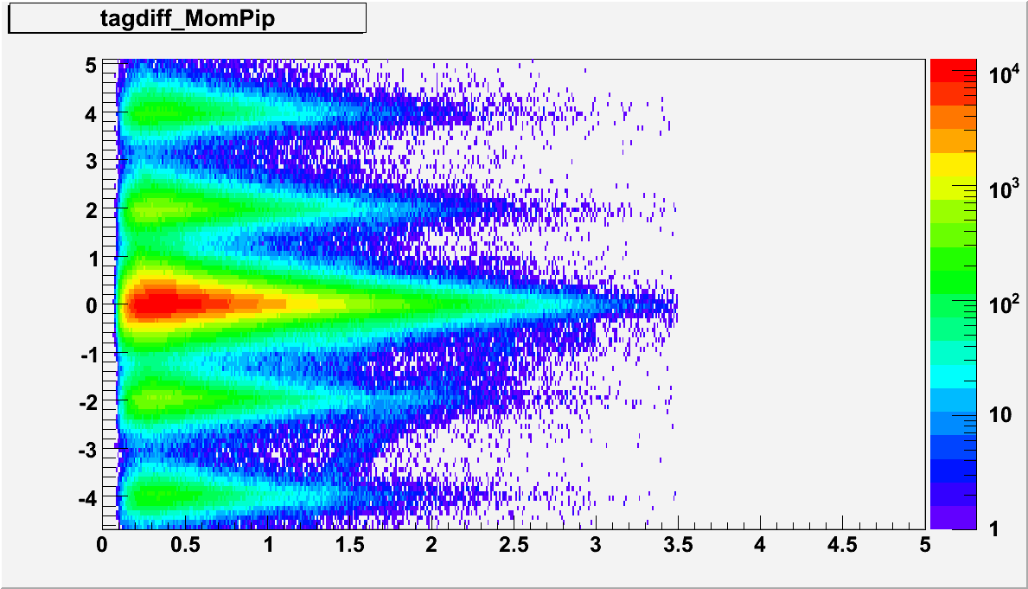
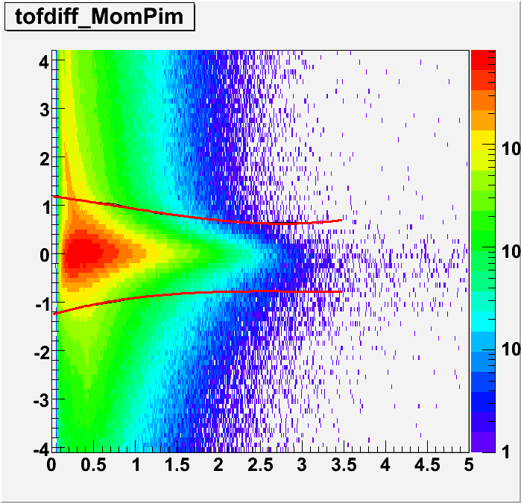
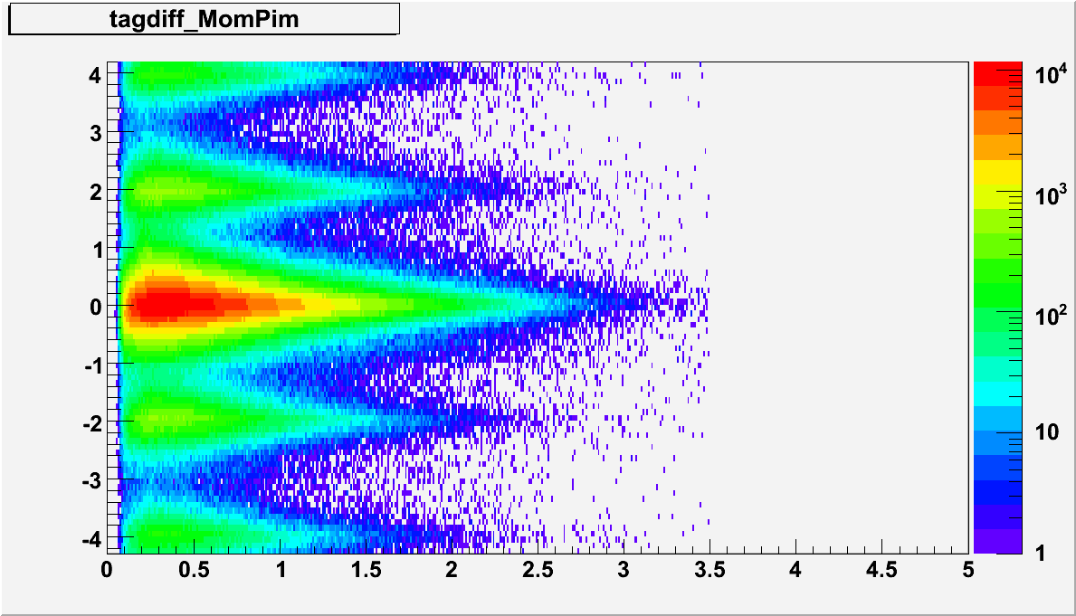
Photon Selection
Neutron
vertex time diff (ns)
vertex and tagger time diff (ns)
π⁺ Mom(GeV)
π⁺ Mom(GeV)
vertex time diff (ns)
vertex and tagger time diff (ns)
π⁻ Mom(GeV)
π⁻ Mom(GeV)

Slide 31
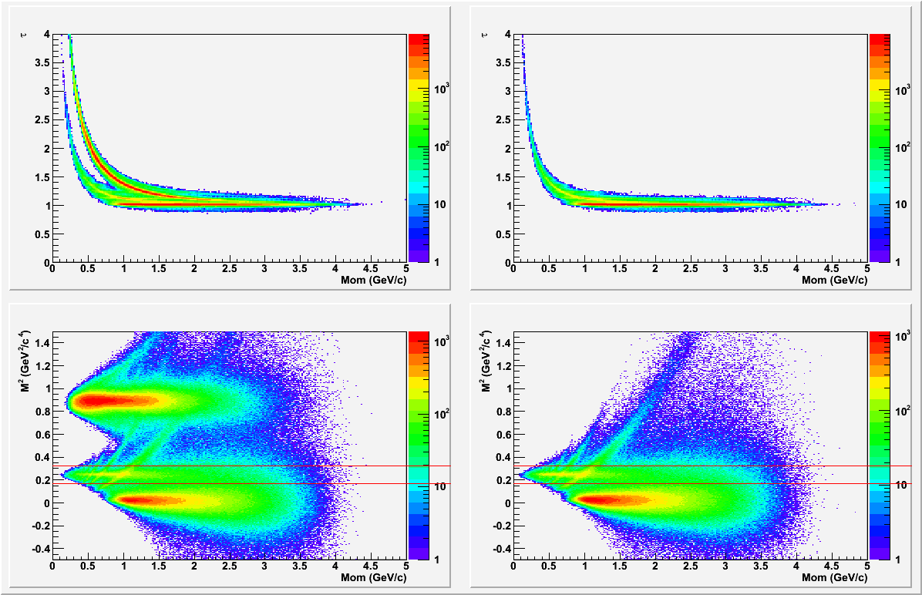
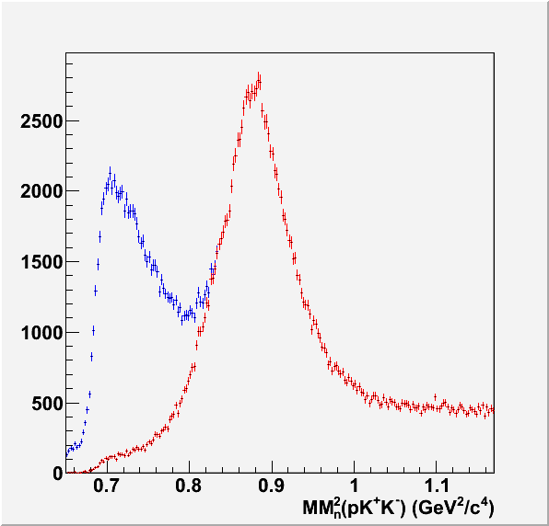
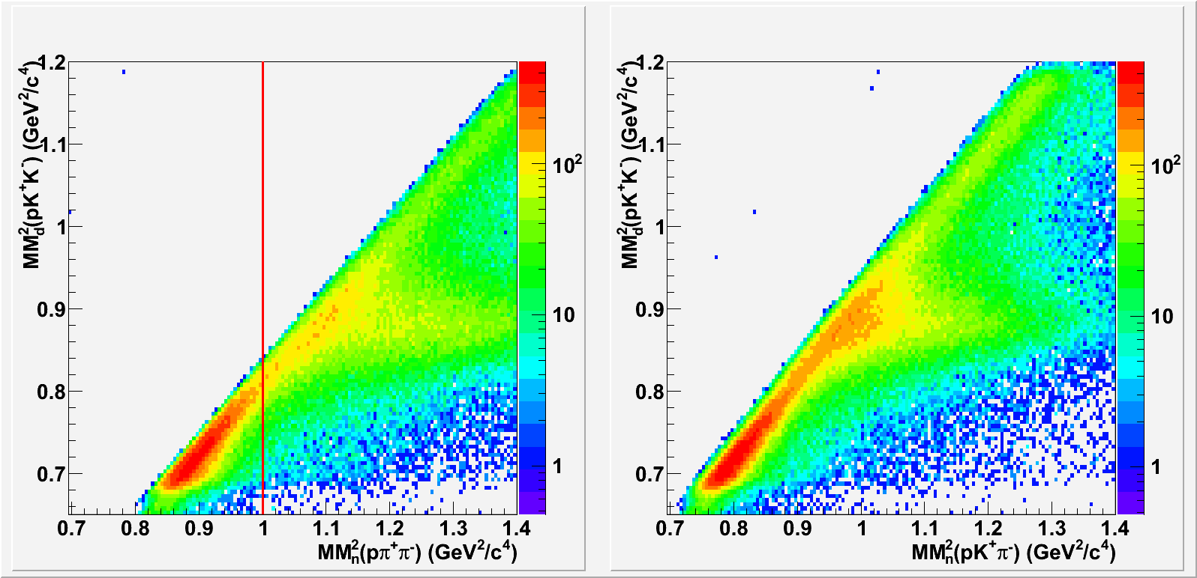
Event Selection
Proton
Positive Negative
τ
Particle timing
Cut misidentified pions
M²
Before and after misid π⁺ π ⁻ cut
Mom (GeV)
MM² (pK⁺ K⁻)(GeV²)
MM² (pK⁺ K⁻)(GeV²)
MM² (pπ⁺π⁻) (GeV²)
MM² (pK⁺π⁻) (GeV²)

Slide 32
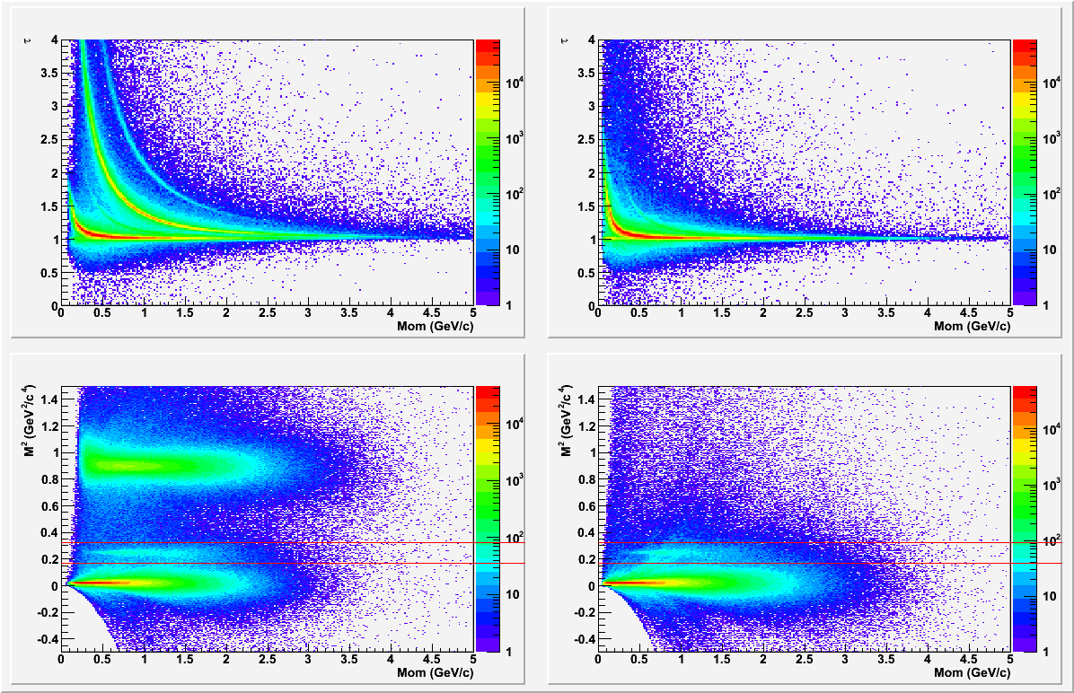
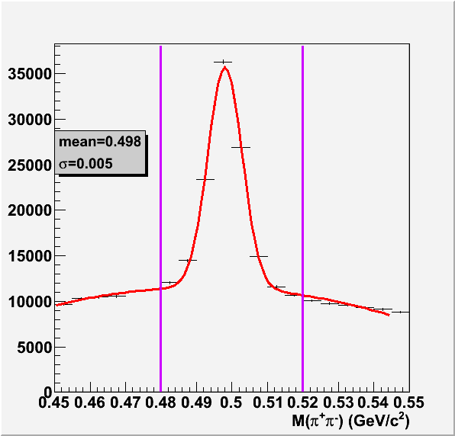
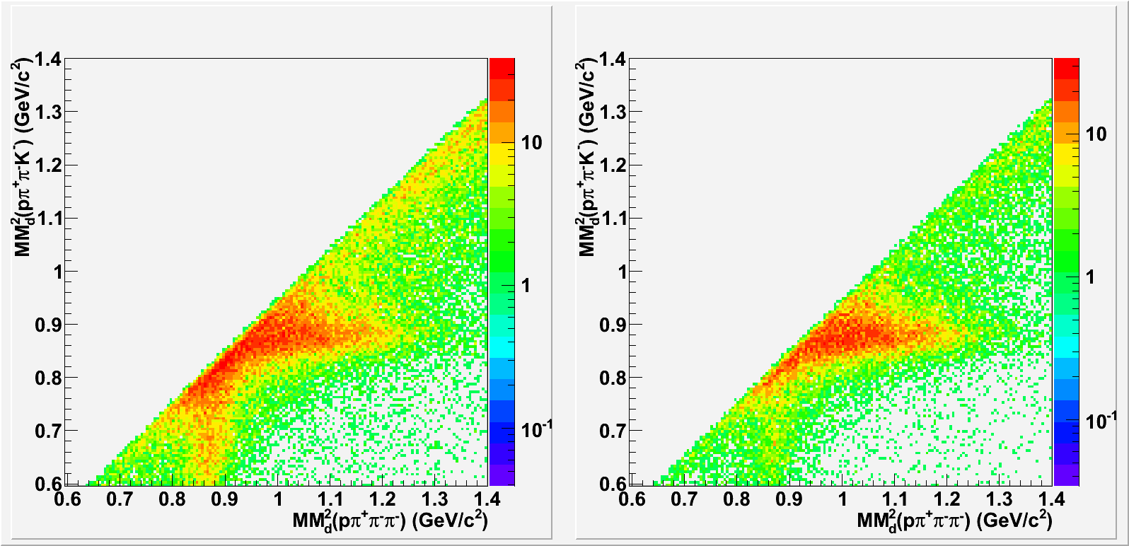
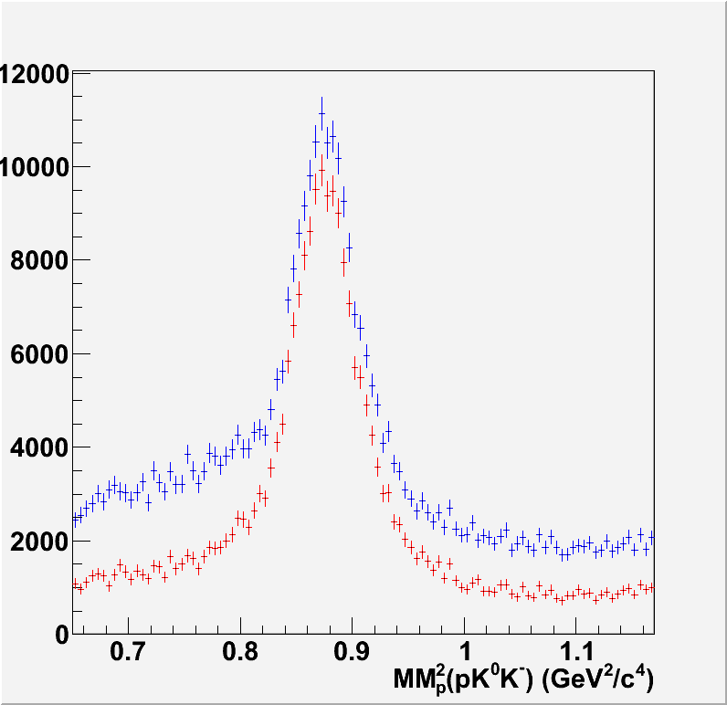
Event Selection
Neutron
Positive Negative
Particle
timing
τ
M²
K_{s} cut
Mom (GeV)
Before K⁰ cut
After K⁰ cut
Before and after K⁰ cut
MM² (pπ⁺π–K⁻)(GeV²)
MM² (pπ⁺π–π–)(GeV²)
MM² (pπ⁺π–K⁻)(GeV²)

Slide 33
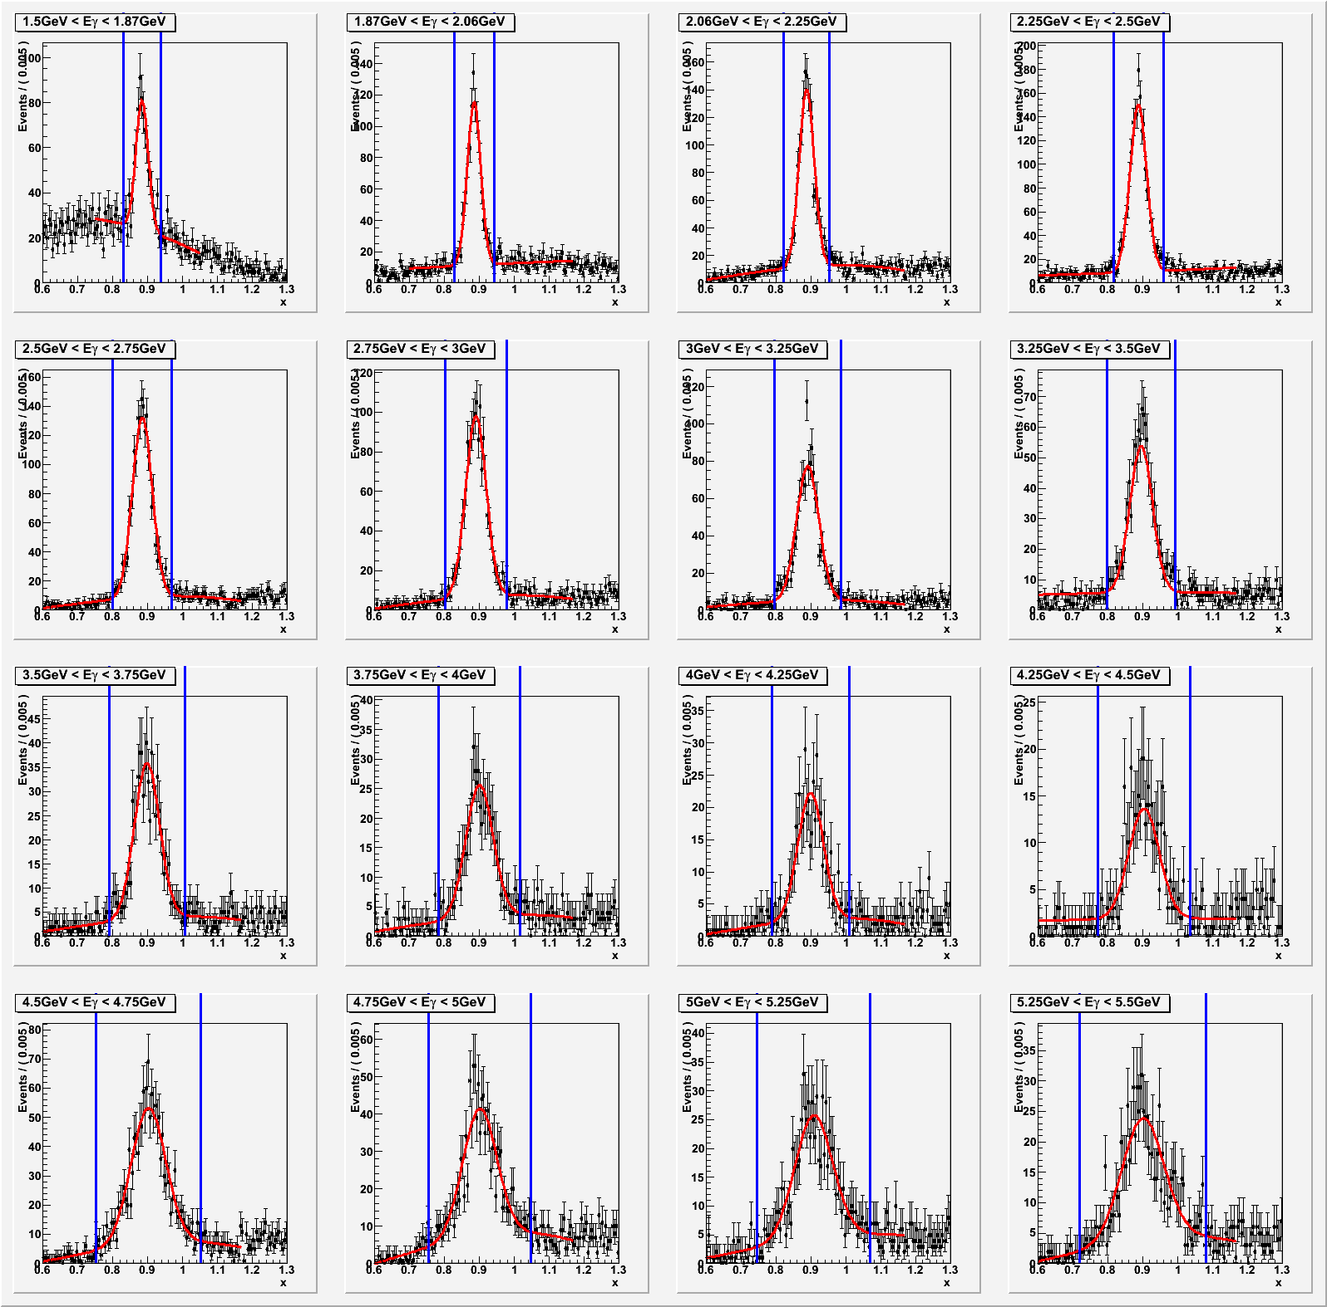
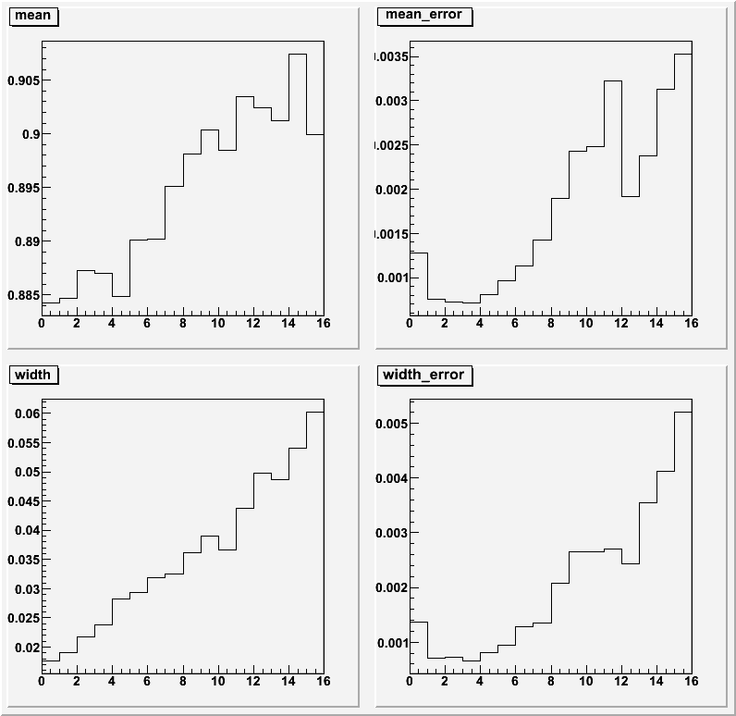
Missing Nucleon Mass
Proton
mean mean error
width width error

Slide 34
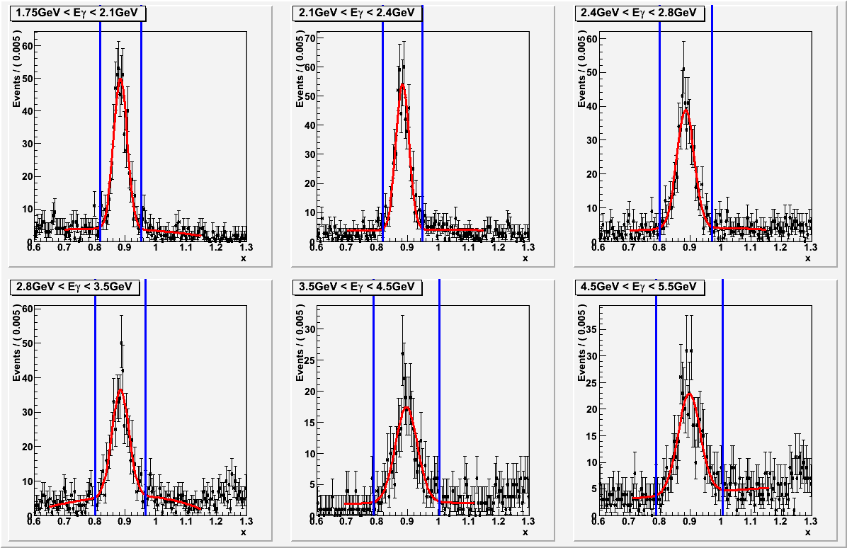
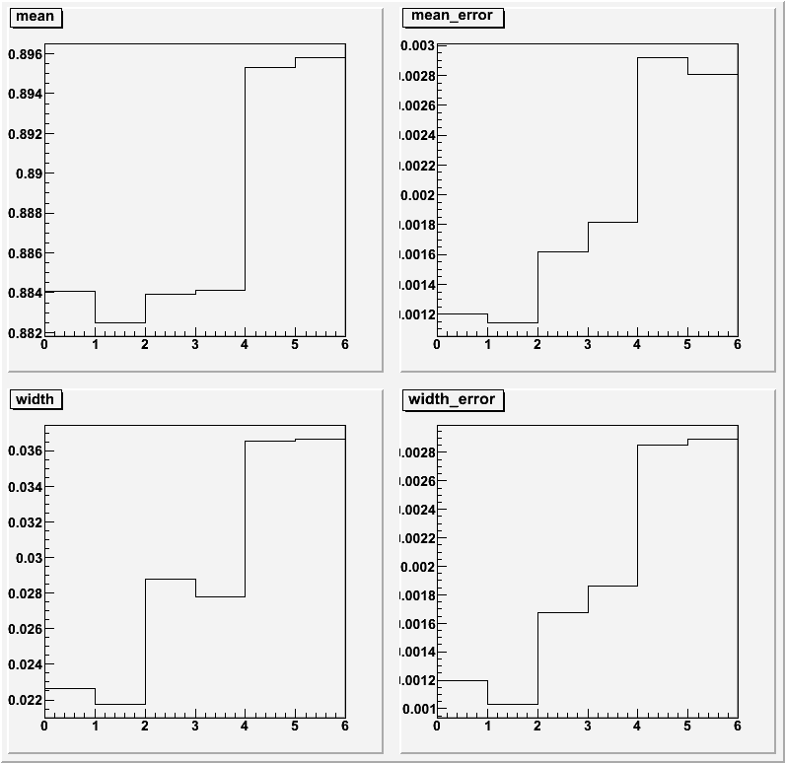
Missing Nucleon Mass
Proton
mean mean error
width width error

Slide 35
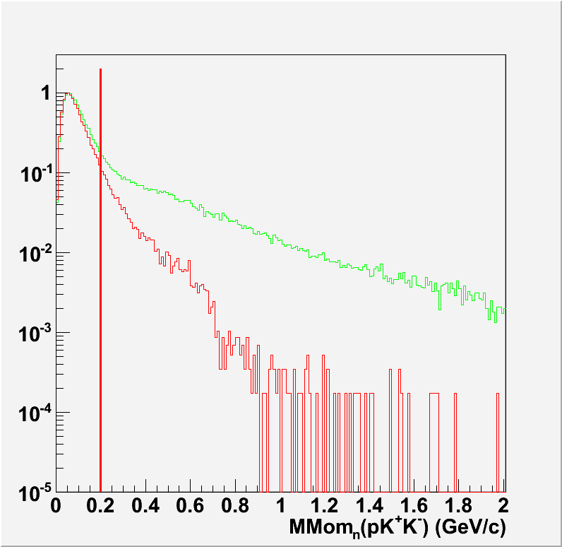
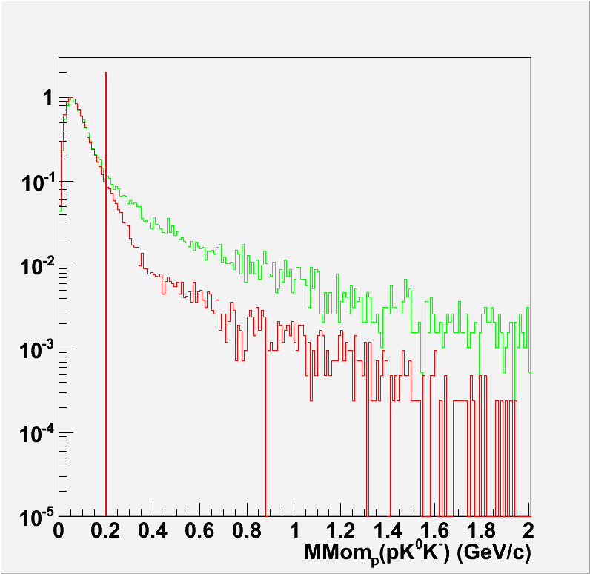
Missing Nucleon Momentum
Proton
Neutron
Data
Sim
Data
Sim

Slide 36

Kinematic Distribution
Proton
1.5 < E_{γ} < 5.5 GeV
16 bins, bin width 250 MeV
-0.8 < cosθ_{K}^{-GJ} < 0.9
6 bins, bin width varies
Data Simulation
cosθ_{K}^{-CJ}
cosθ_{K}^{-CJ}
E_{γ} (GeV)
E_{γ} (GeV)

Slide 37

Kinematic Distribution
Neutron
1.5 < E_{γ} < 5.5 GeV
6 bins, bin width varies
-0.8 < cosθ_{K}^{-GJ} < 0.9
6 bins, bin width varies
Data Simulation
cosθ_{K}^{-CJ}
cosθ_{K}^{-CJ}
E_{γ} (GeV)
E_{γ} (GeV)

Slide 38


Yield Extraction (data)
Proton
1.5 < E_{γ} < 5.5 GeV
16 bins, bin width 250 MeV
M(pK⁻) (GeV)
0.25 < t* = -(t-t₀) < 3.0 GeV²
6 bins, bin width varies
M(pK⁻) (GeV)

Slide 39


Yield Extraction (data)
Neutron
1.5 < E_{γ} < 5.5 GeV
6 bins, bin width varies
M(pK⁻) (GeV)
0.0 < t* = -(t-t₀) < 3.0 GeV²
6 bins, bin width varies
M(pK⁻) (GeV)

Slide 40


Yield and Acceptance
Proton
Data Simulation
Yield
Yield
# of generated
Acceptance
Eγ, t* bin t* bin Eγ bin

Slide 41


Yield and Acceptance
Neutron
Data Simulation
Yield
Yield
# of generated
Acceptance
Eγ, t* bin t* bin Eγ bin

Slide 42

SAPHIR

Slide 43

SAPHIR

